Slide 1
Faster. Easier. Smarter.
Presenter
Date
For Agent Use Only. This material may not be used with the public.
Insurance policies and/or associated riders and features may not be available in all states.
Insurance products are issued by John Hancock Life Insurance Company (U.S.A.), Boston, MA 02210 (not licensed in New York) and John Hancock Life Insurance Company of New York, Valhalla, NY 10595.
LIFE-6839 06/17 MLINY061217061

Slide 2
Faster. Easier. Smarter.
We’ve made selling life insurance easier than ever with our new ticket submission process and John Hancock ExpressTrackTM!
With our new JH Life eTicket and JH Life Paper Ticket (coming soon), it’s now about spending less time on paperwork and more time on selling
Provide some basic information and John Hancock handles the rest
Convenient tracking through your usual case status tools
JH Life eTicket is available for single-life term products; JH Life Paper Ticket (coming soon) for single-life term & permanent products
Both Tickets available for all ages and face amounts (except juveniles), based on regular product rules

Slide 3
Another benefit of the new ticket submission: ExpressTrack
Now, when applications are initiated via the new ticket process, eligible clients* will be considered for quicker underwriting decisions with ExpressTrack.
Underwriting decision (Standard to Super Preferred) in as little as three days from the time John Hancock receives the completed tele-application results
No in-person paramedical nurse visit
No lab work
No additional pre-issue medical underwriting requirements
*Consumers, ages18-60, initiating their application with a John Hancock proprietary ticket and applying for single life coverage of up to and including $1 million may qualify for John Hancock ExpressTrack.

Slide 4
How does it work?
ExpressTrack QUALIFIERS
“No-touch” decision*
Your client is eligible for any risk class from Standard to Super Preferred
Following telephone interview, underwriting path is determined based on age, face amount and health and lifestyle profile
Traditional Underwriting
Additional underwriting requirements needed (e.g., blood, urine, APS, etc.)
Your client may be assessed at any risk class from Super Preferred to declined
* John Hancock will be requesting a post-issue attending physician statement (APS) for every issued ExpressTrack case. A policy may be rescinded if information in the APS reveals a material misrepresentation in the application submitted.

Slide 5
Who will be considered for ExpressTrack?
Applications initiated via JH Life eTicket, JH Life Paper Ticket, or ApplicInt’s Express Complete
Ages 18-60
Face amount up to and including $1M
Single-life perm and term products, including LTC rider
Generally considered Standard or better risk class
U.S. permanent residents
Underwriting makes offer in as little as three days, no additional medical requirements needed*
* John Hancock will be requesting a post-issue attending physician statement (APS) for every issued ExpressTrack case. A policy may be rescinded if information in the APS reveals a material misrepresentation in the application submitted.

Slide 6
Who will most likely receive an ExpressTrack experience?
Apart from the basic face and age parameters, applicants most likely to receive an ExpressTrack experience are those that:
Do not have serious medical impairments or histories
Do not participate in hazardous sports or occupations
Do not have complex financials, or criminal histories
EXAMPLES OF MEDICAL IMPAIRMENTS REQUIRING FULL MEDICAL REQUIREMENTS* | EXAMPLES OF NON-MEDICAL IMPAIRMENTS REQUIRING FULL UNDERWRITING REQUIREMENTS*
Diabetes/gestational diabetes Cancer history (other than basal and squamouscell skin cancers) Stroke/TIA Lupus/autoimmune disorders COPD/emphysema CAD Moderate/severe ulcerative colitis Fatty liver Heart murmurs, valvular disease Hepatitis Rheumatoid arthritis | Aviation & hazardous sports (resort diving is eligible) Professional athletes & entertainers Hazardous occupations History of DUI or bankruptcy Criminal histories Premium financing Increasing riders Prior submissions, including trial or formal applications, received in the past 12 months Previously rated or declined Histories of substance abuse Complex ownerships such as charities or “to-be- established” Trusts
*These examples are illustrative and not exhaustive. John Hancock reserves the right to require additional underwriting requirements in connection with any application for insurance.

Slide 7
ExpressTrack in Action
AMY, 56, OWNER OF A FLOWER SHOP
Amy wants to purchase a $1 million Protection UL policy to be used for key-person coverage. Amy’s insurance representative submitted her application via a John Hancock proprietary Ticket, and within 24 hours a John Hancock representative contacted Amy to schedule a tele-interview with her to collect the application and medical history details.
Amy’s overall history is good, with normal build and controlled blood pressure, parents in good health, with clear MIB and MVR. Her application indicates that she has been treated for hypertension and sleep apnea.
John Hancock Underwriting reviewed the completed application, and determined that Amy qualifies for ExpressTrack. Within three days of receiving the completed application, the underwriter communicated a “Preferred” underwriting decision to Amy’s insurance representative.

Slide 8
JH Life Tickets & ExpressTrack: Overview
PRODUCER SUBMITS TICKET
JH Life eTicket, JH Life Paper Ticket (coming soon), or Applicant’s Express Complete Multi-Carrier Ticket
Prior to the client being contacted to complete his/her tele-interview, provide the client with our Preparing For Your Telephone Interview flyer
TELEPHONE INTERVIEW WITH CLIENT
Conducted by a John Hancock representative who completes the application and orders paramedical exam if needed
Client signs application (eSignature is encouraged for quicker processing)
CASE PROCEEDS TO UNDERWRITING
Underwriting review — will be considered for ExpressTrack or go through traditional underwriting
POLICY ISSUED AND DELIVERED

Slide 9
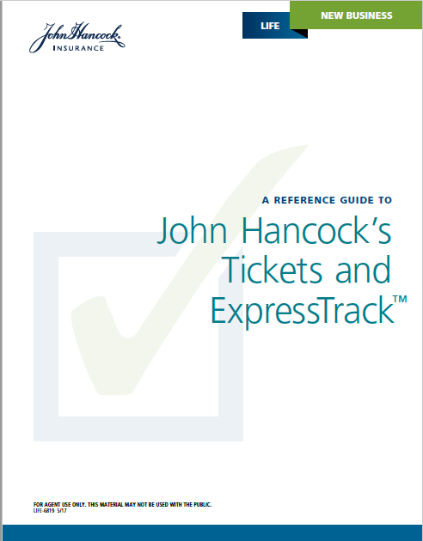
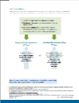
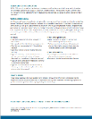
Marketing materials
ANNOUNCEMENT FLYER (LIFE-6822)
Use this flyer to share the news with your producers
COMPREHENSIVE REFERENCE GUIDE (LIFE-6819)
Find answers to frequently asked questions, as well as a detailed overview of how the Ticket and ExpressTrack processes work
EXPRESSTRACK FLYER (LIFE-6838)
Refer to this flyer for information specific to ExpressTrack
PREPARING FOR TELEPHONE INTERVIEW FLYER (LIFE-6828)
Consumer flyer to help them what to expecting during, and following, the telephone interview
JH LIFE ETICKET BUTTON FOR YOUR WEBSITE
Use this button if you’d like to add a custom link to your website. Contact your John Hancock Salesperson for details

Slide 10
QUESTIONS?

